Slide 1
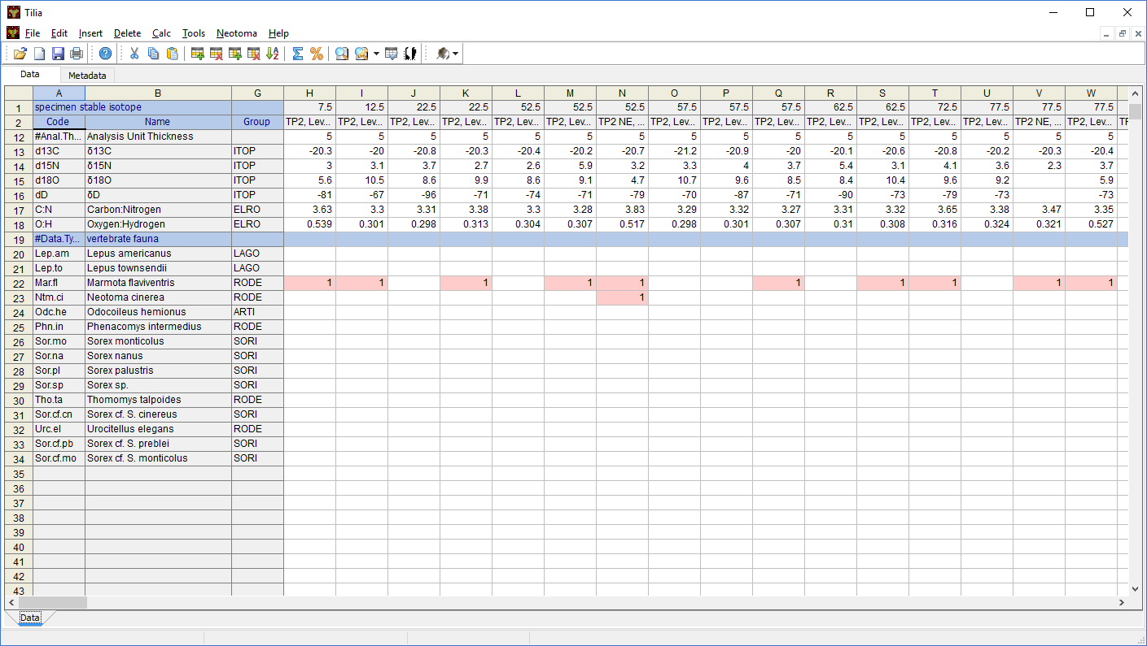
Tilia Updates and Advances
Neotoma All-Hands Meeting
CSDCO, University of Minnesota, Twin Cities
January 14-15, 2019

Slide 2
Tilia Updates and Advances
Specimen data
Radiocarbon dates
Specimen stable isotopes
Uploading datasets to existing collection units and analysis units
Updating datasets already in Neotoma
Text based interface for downloading data from Neotoma

Slide 3
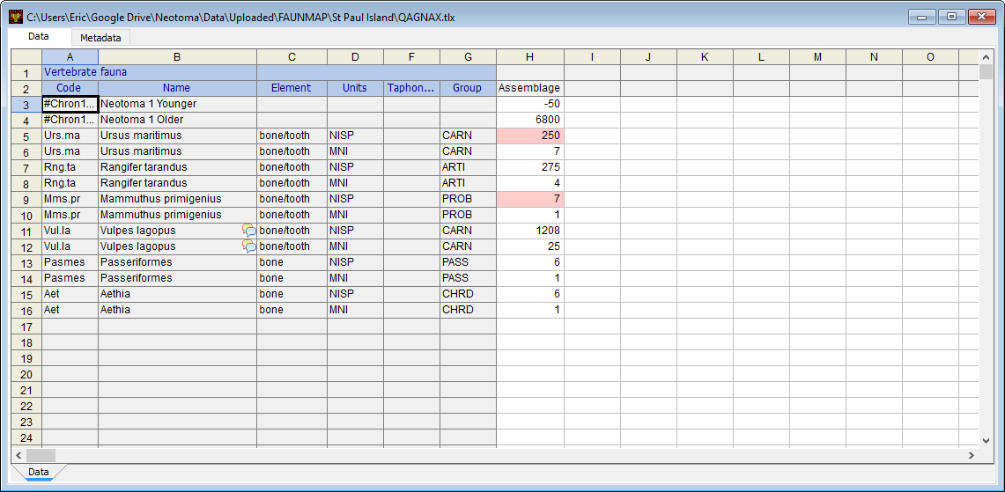
Specimen Data

Slide 4
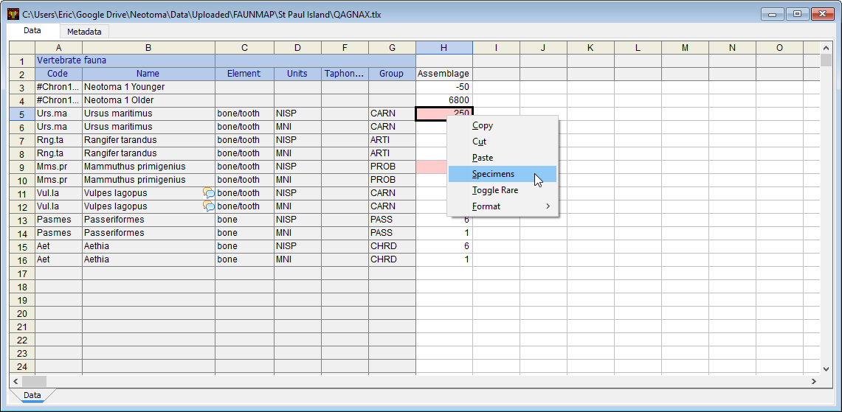
Specimen Data

Slide 5
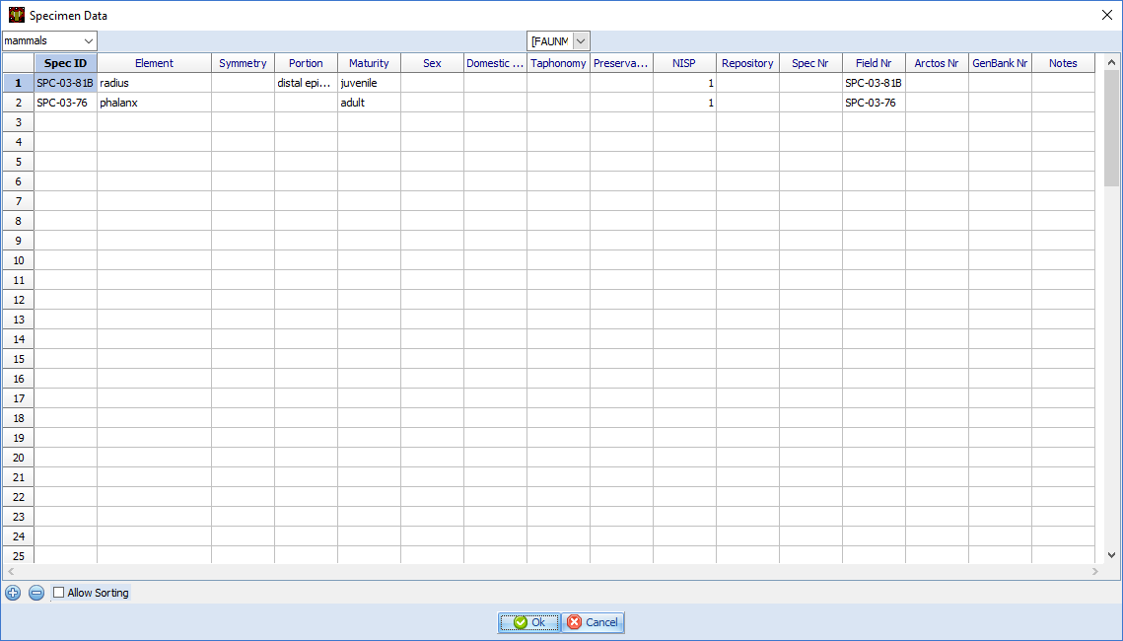
Specimen Data

Slide 6
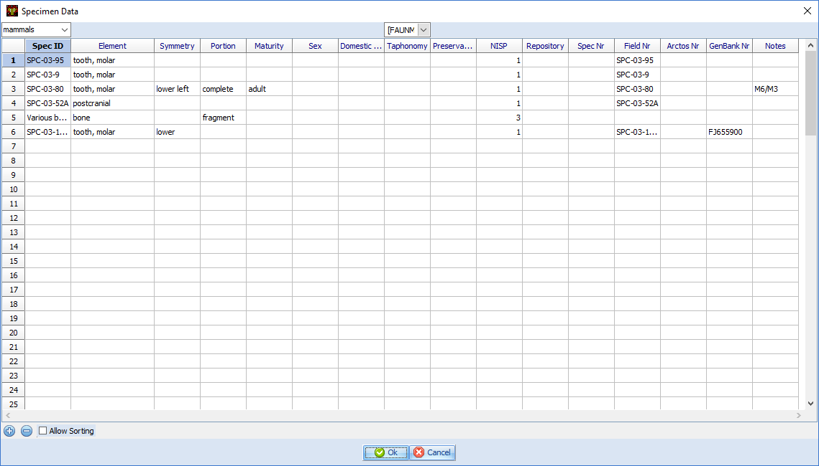
Specimen Data

Slide 7
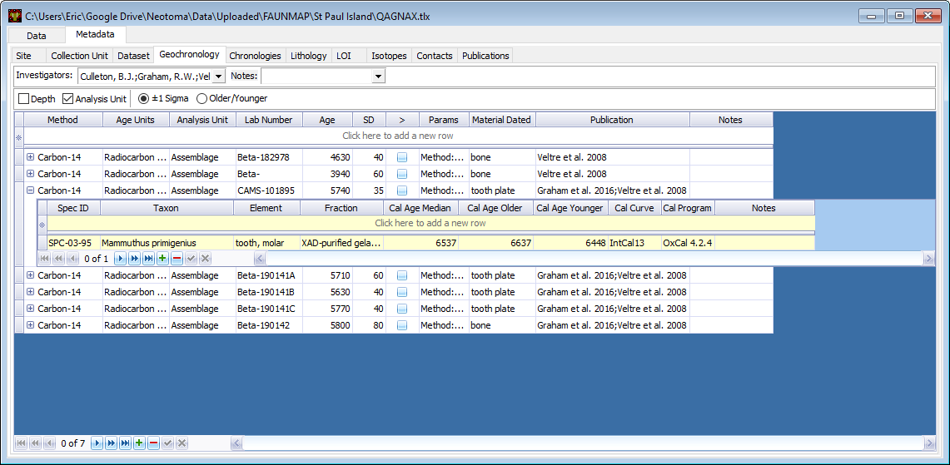
Specimen Data

Slide 8
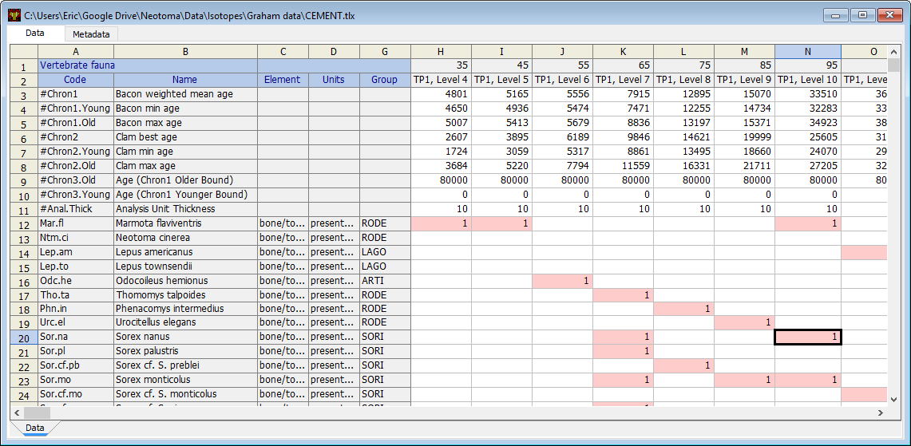
Specimen Data

Slide 9
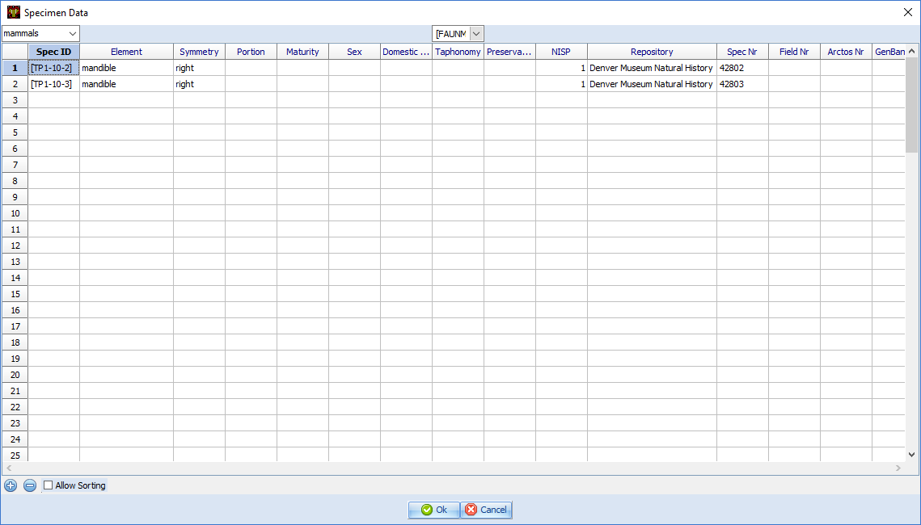
Specimen Data

Slide 10
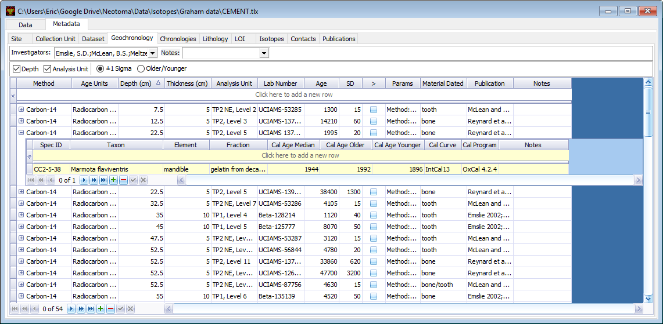
Specimen Data

Slide 11
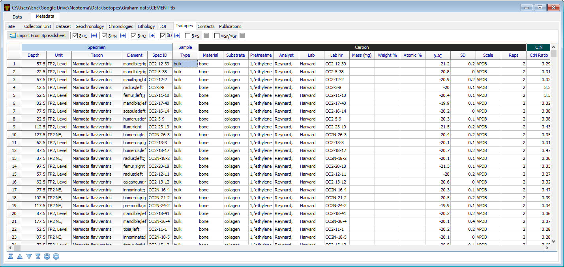
Specimen Data

Slide 12
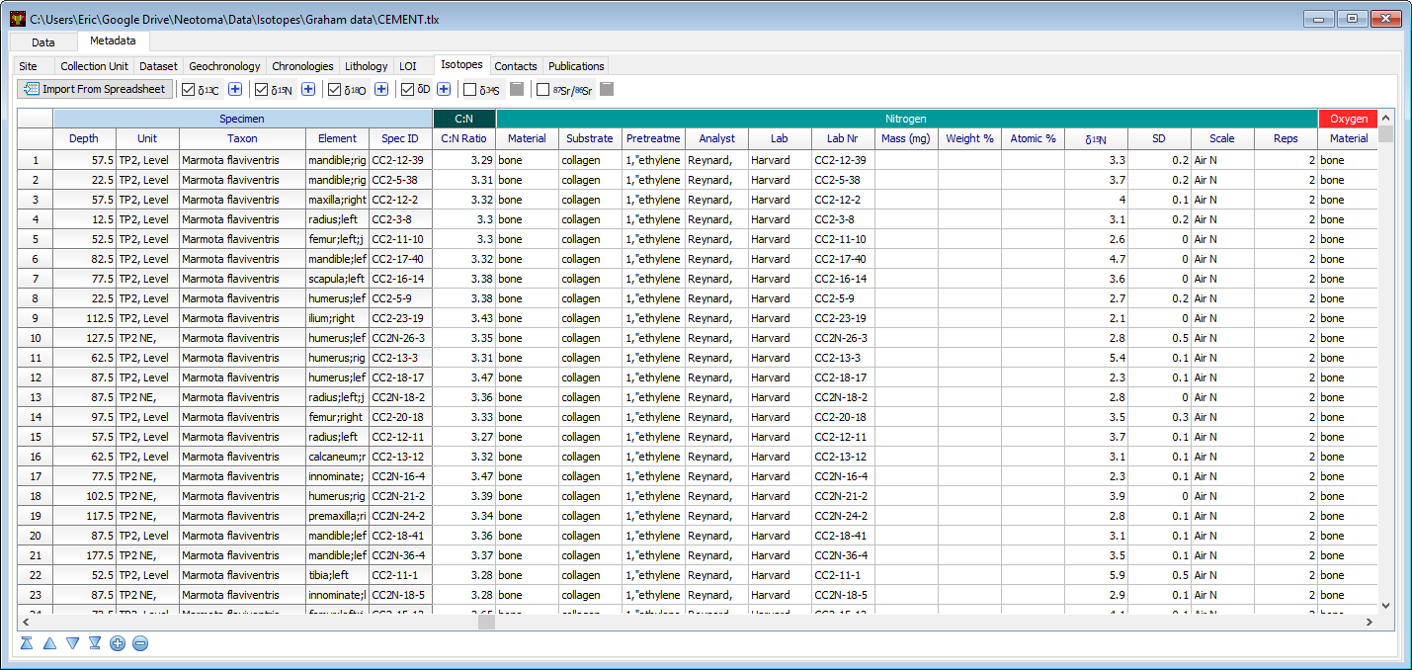
Specimen Data

Slide 13
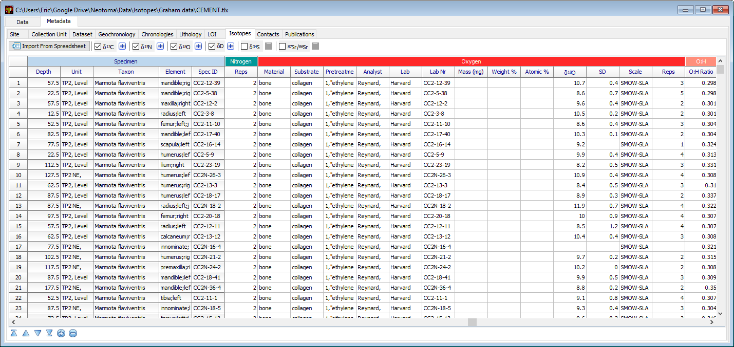
Specimen Data

Slide 14
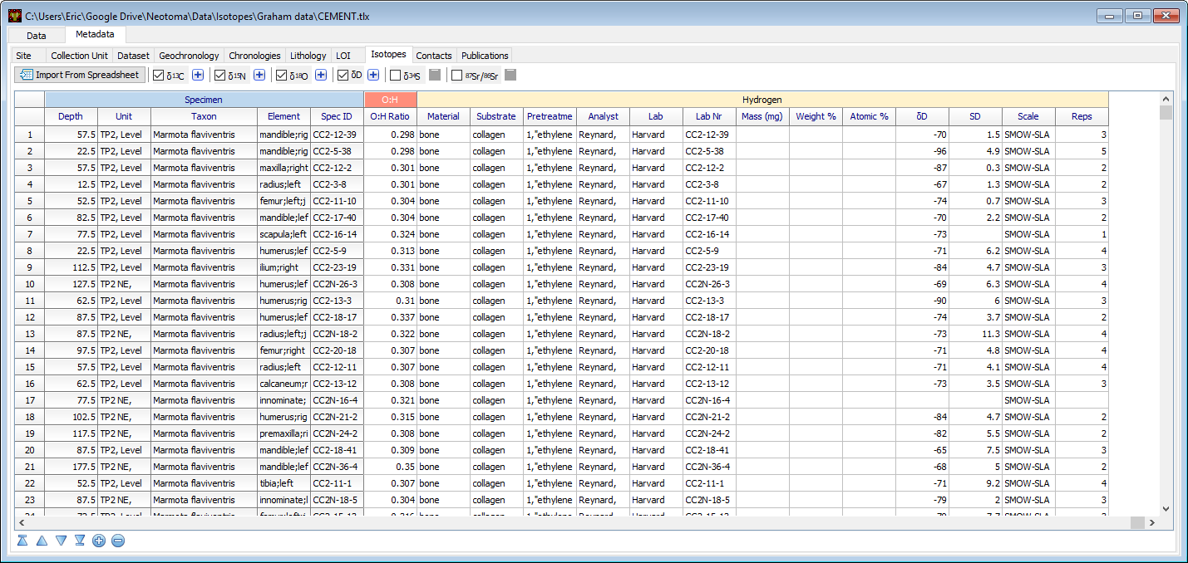
Specimen Data

Slide 15

Specimen Data

Slide 16
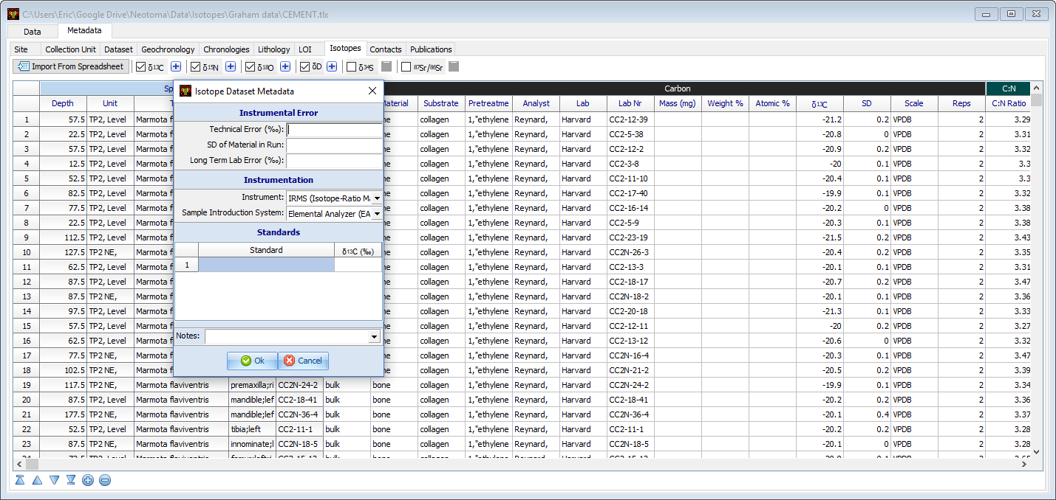
Specimen Data

Slide 17
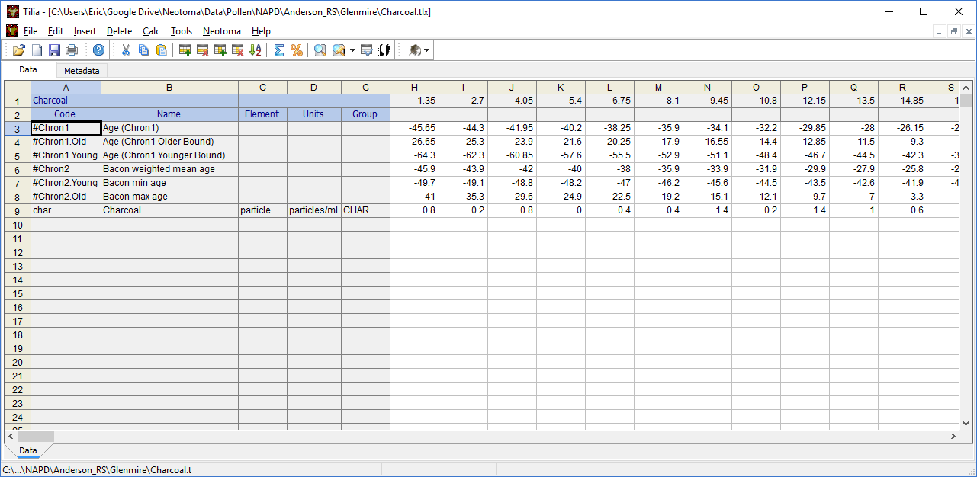
Uploading Datasets to Existing Collection Units and Analysis Units

Slide 18
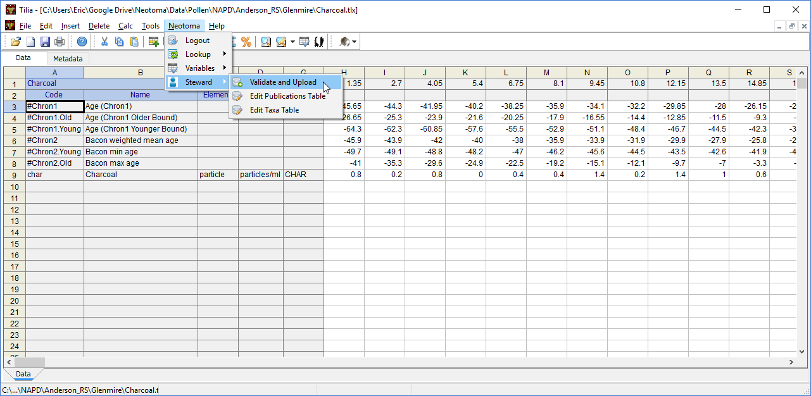
Uploading Datasets to Existing Collection Units and Analysis Units

Slide 19
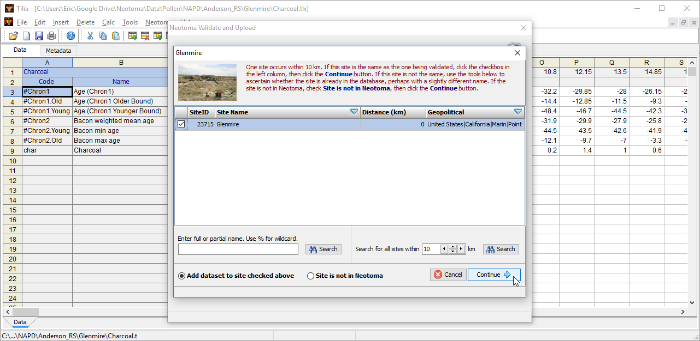
Uploading Datasets to Existing Collection Units and Analysis Units

Slide 20
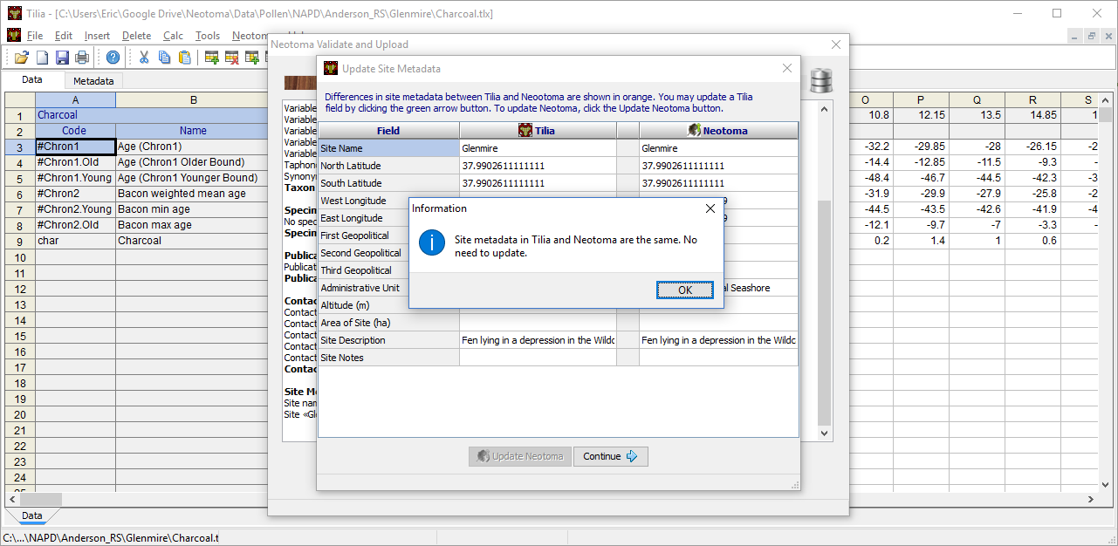
Uploading Datasets to Existing Collection Units and Analysis Units

Slide 21
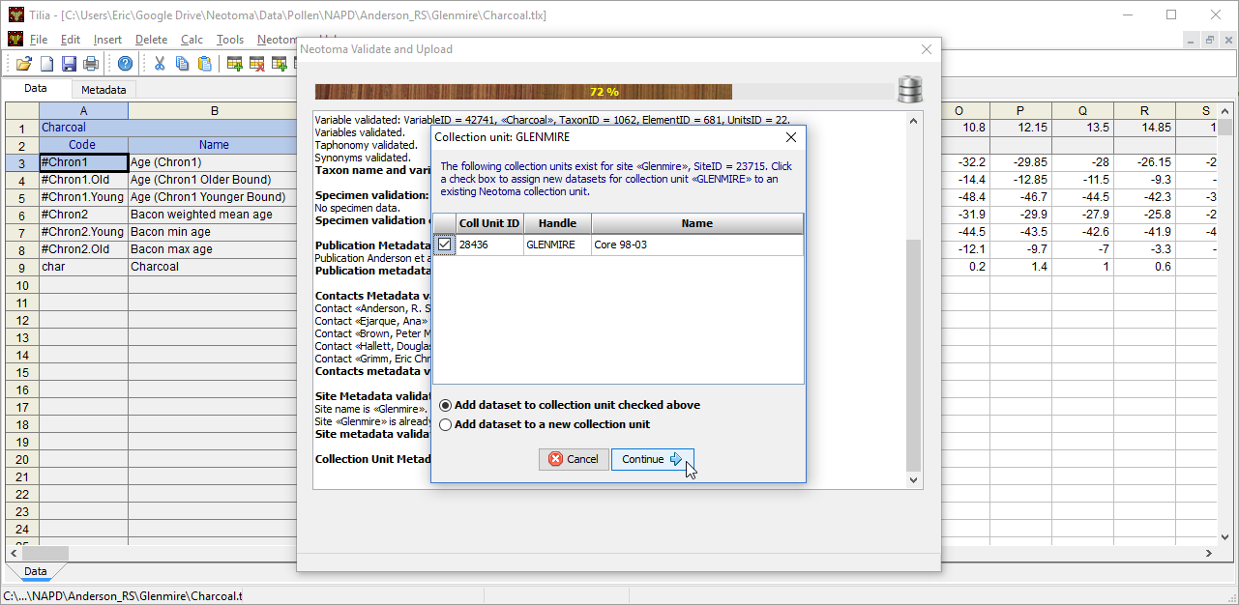
Uploading Datasets to Existing Collection Units and Analysis Units

Slide 22
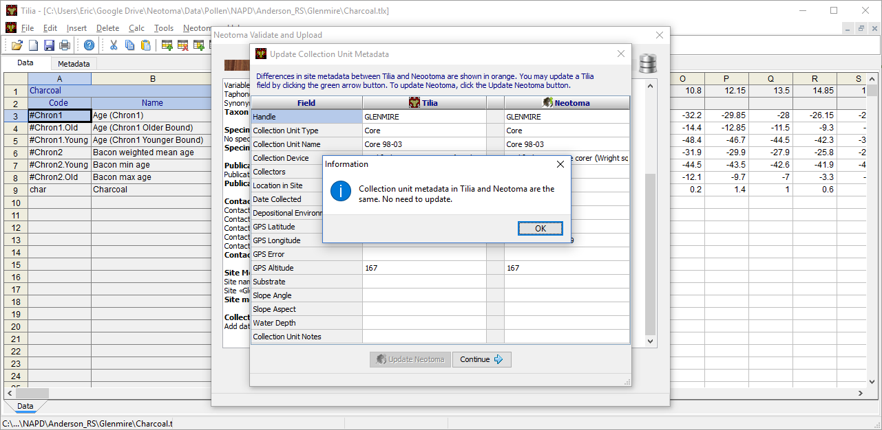
Uploading Datasets to Existing Collection Units and Analysis Units

Slide 23
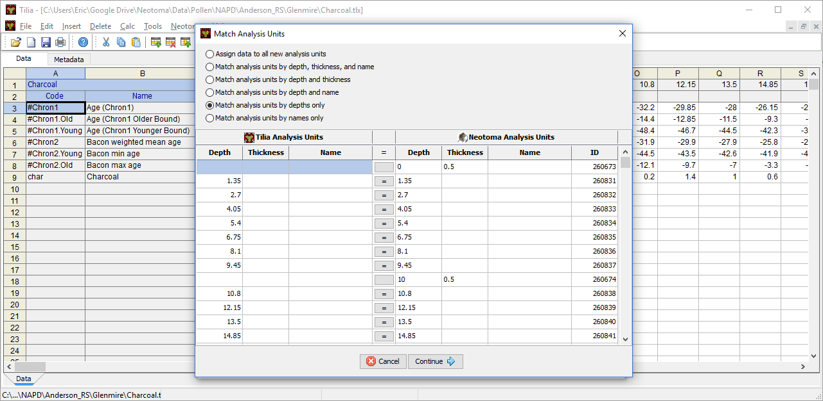
Uploading Datasets to Existing Collection Units and Analysis Units

Slide 24
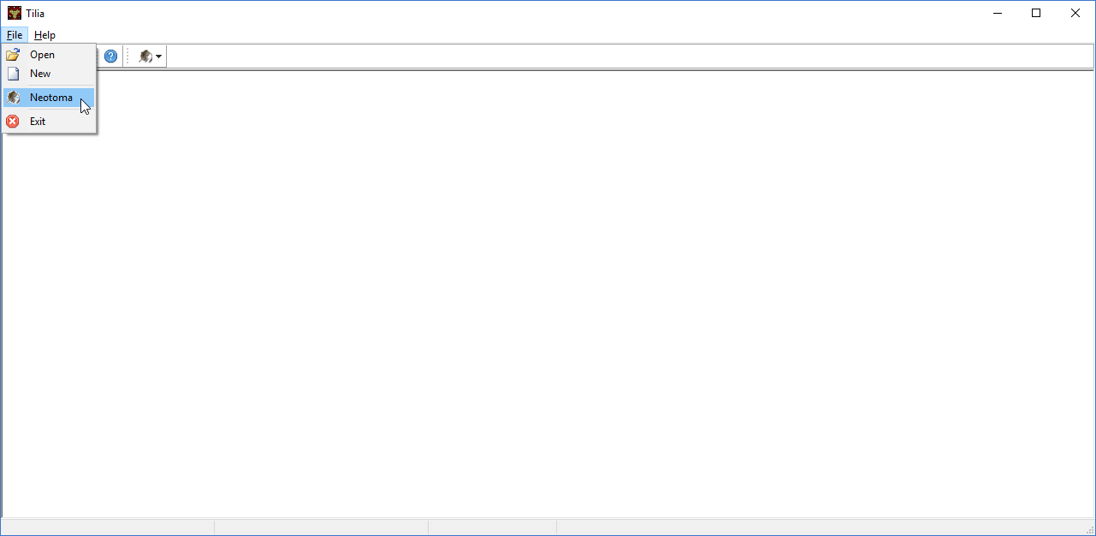
Updating Datasets already in Neotoma

Slide 25
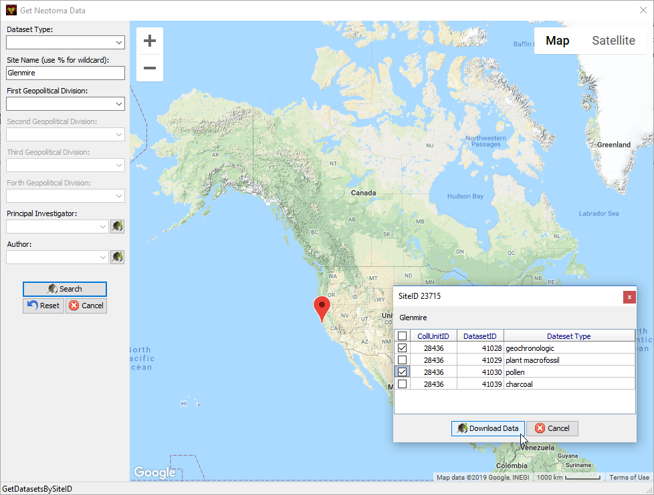
Updating Datasets already in Neotoma

Slide 26
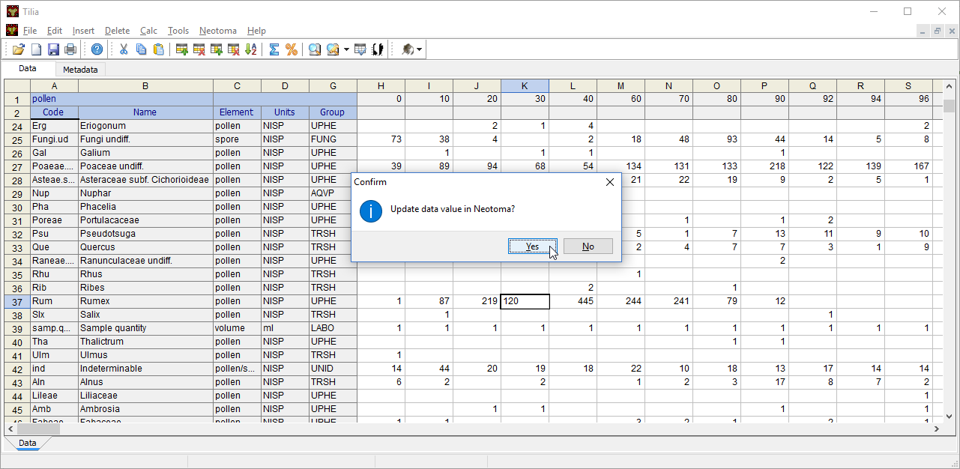
Updating Datasets already in Neotoma

Slide 27
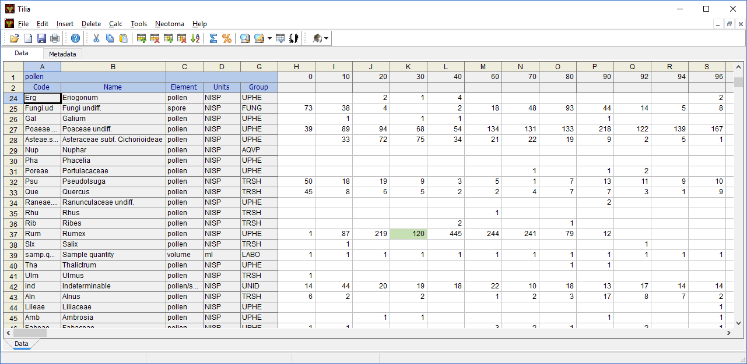
Updating Datasets already in Neotoma

Slide 28
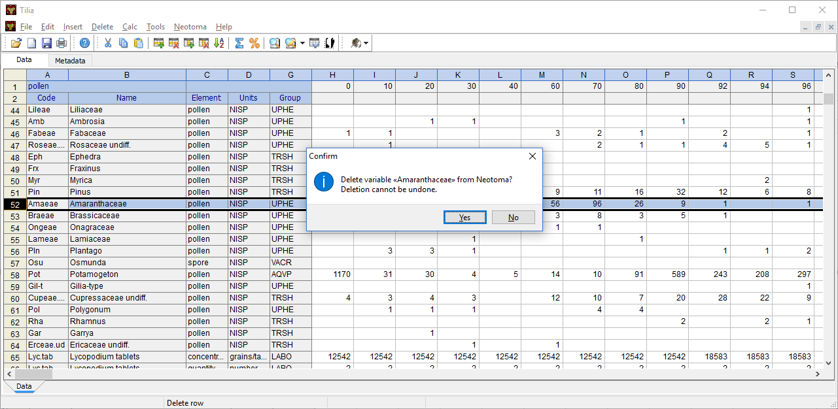
Updating Datasets already in Neotoma

Slide 29
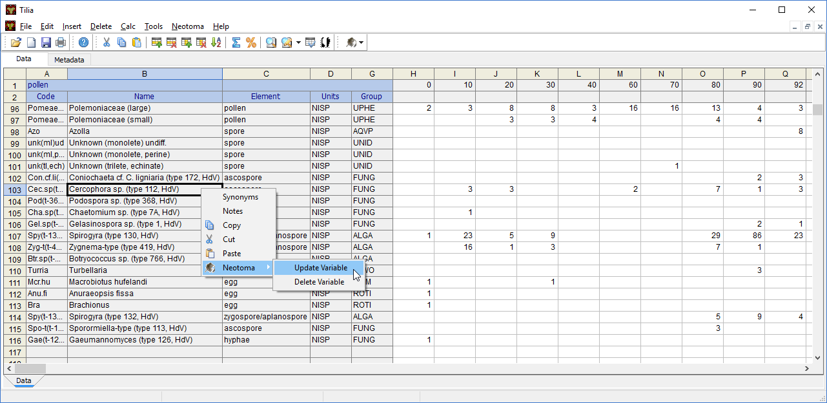
Updating Datasets already in Neotoma

Slide 30
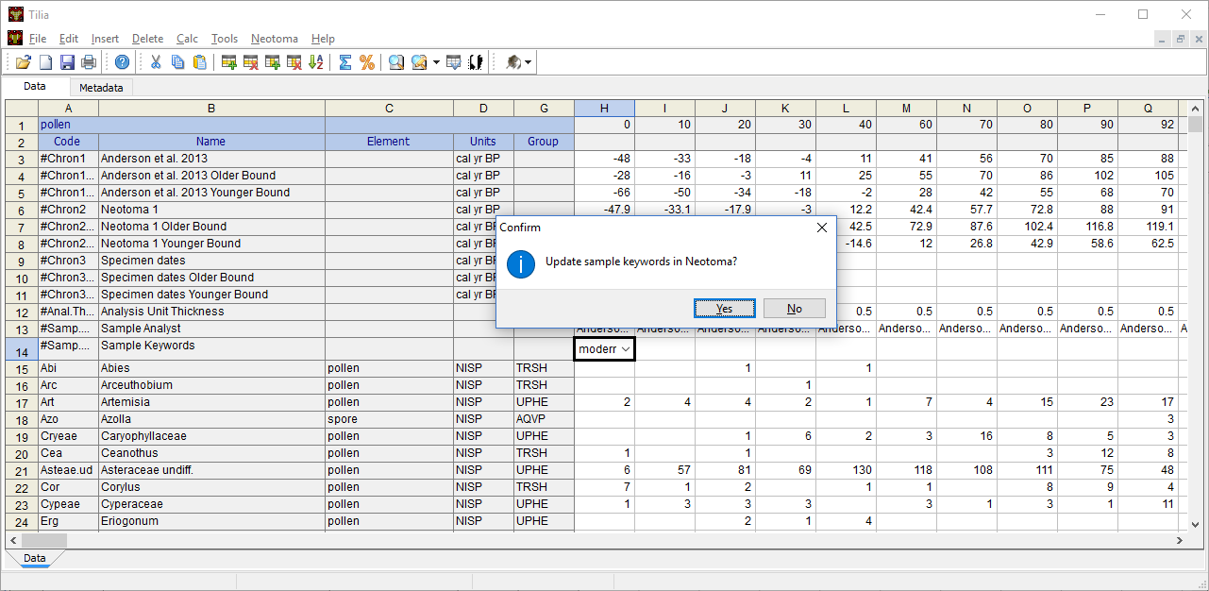
Updating Datasets already in Neotoma

Slide 31
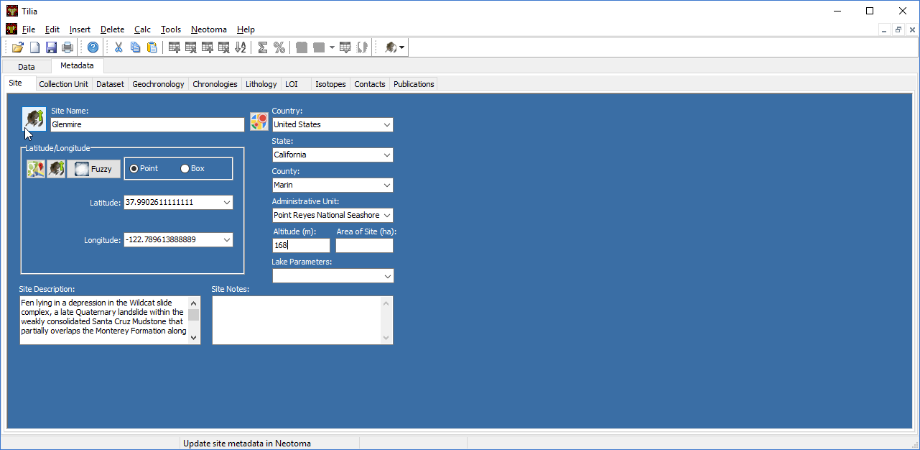
Updating Datasets already in Neotoma

Slide 32
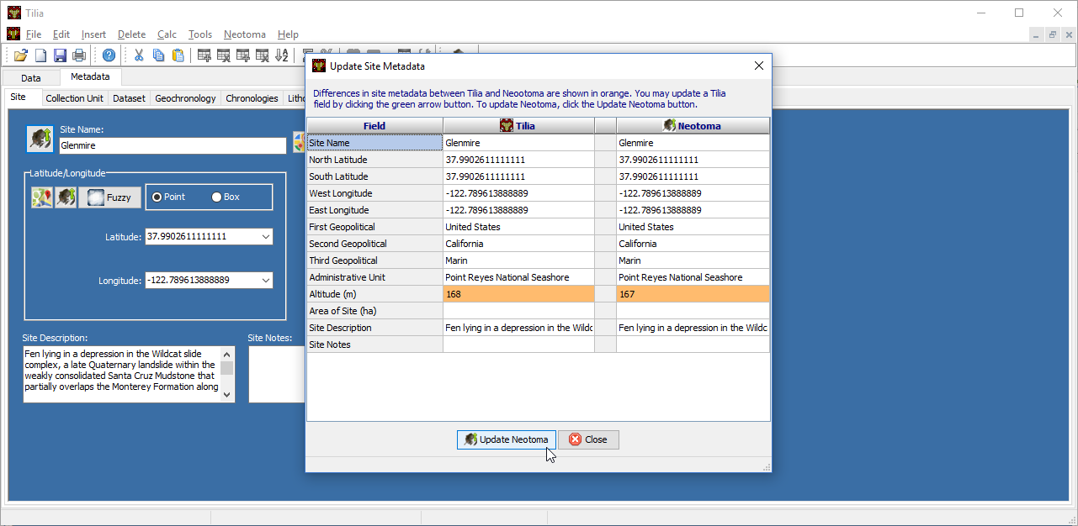
Updating Datasets already in Neotoma

Slide 33
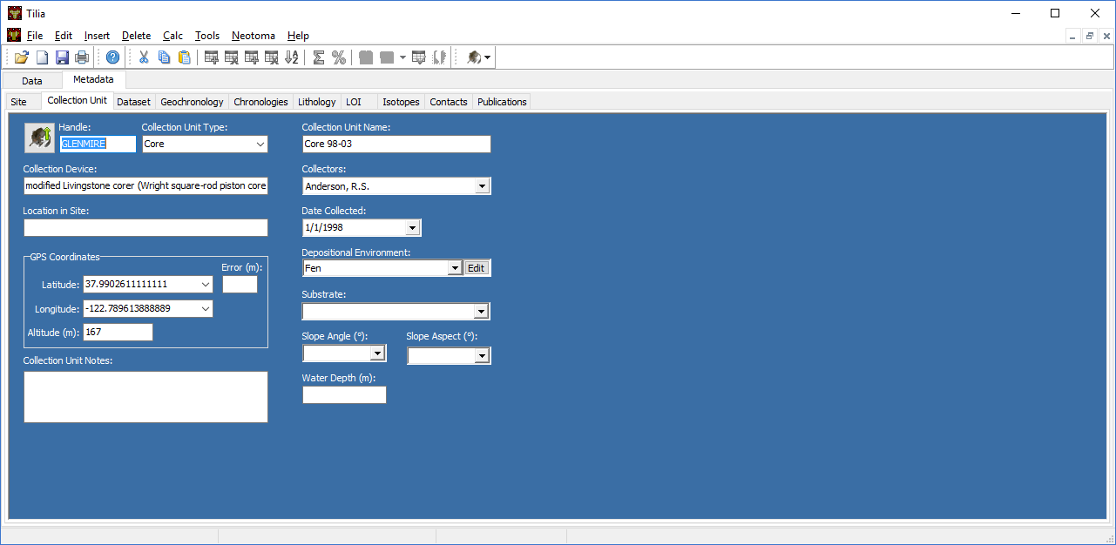
Updating Datasets already in Neotoma

Slide 34
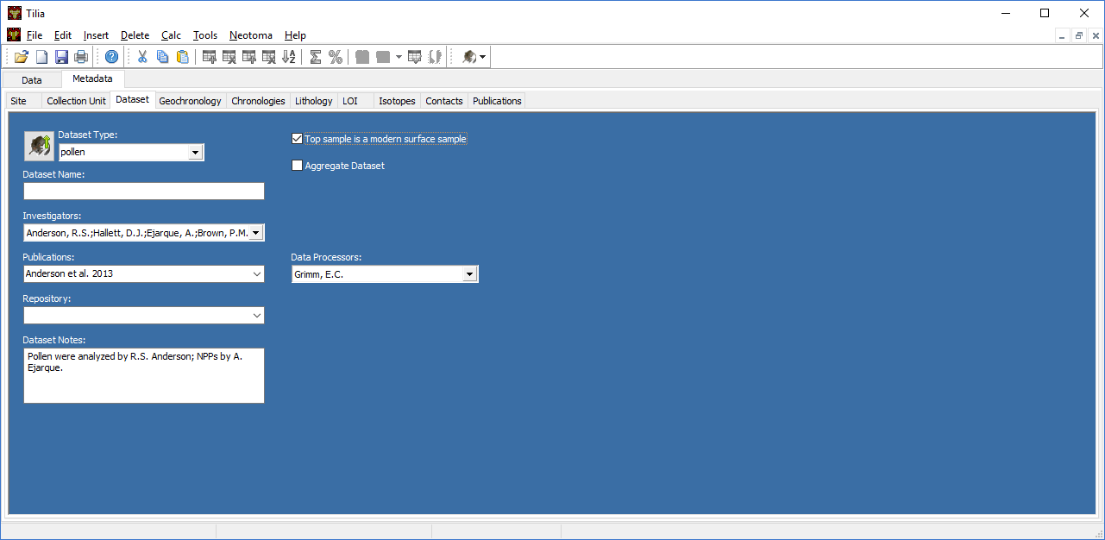
Updating Datasets already in Neotoma

Slide 35
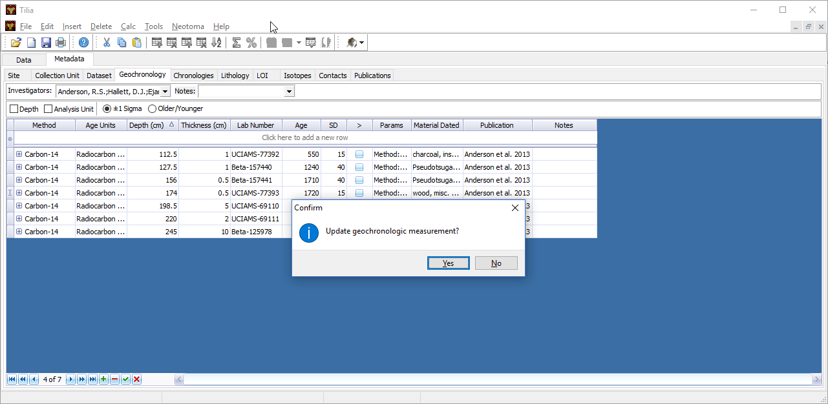
Updating Datasets already in Neotoma

Slide 36
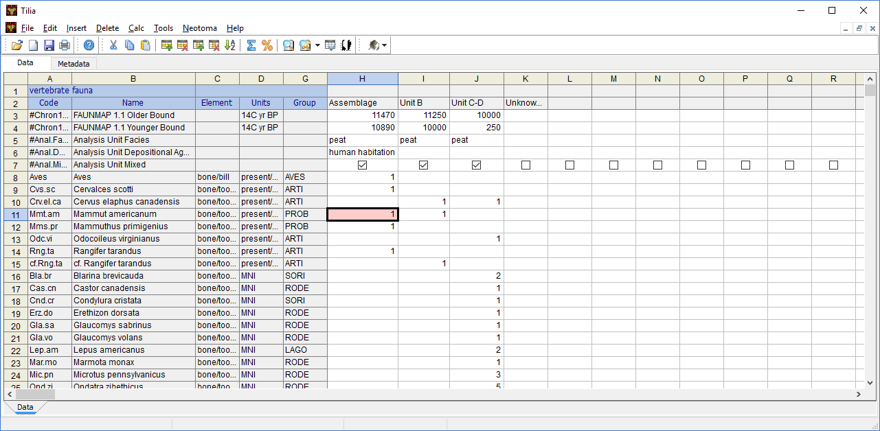
Updating Datasets already in Neotoma

Slide 37
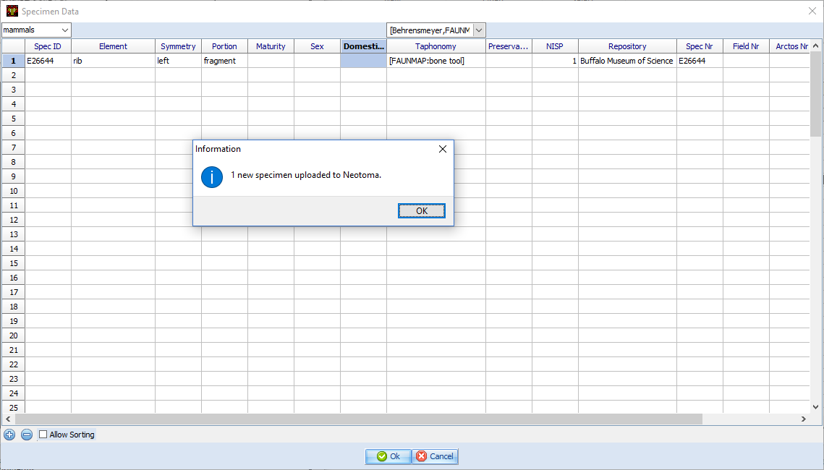
Updating Datasets already in Neotoma

Slide 38
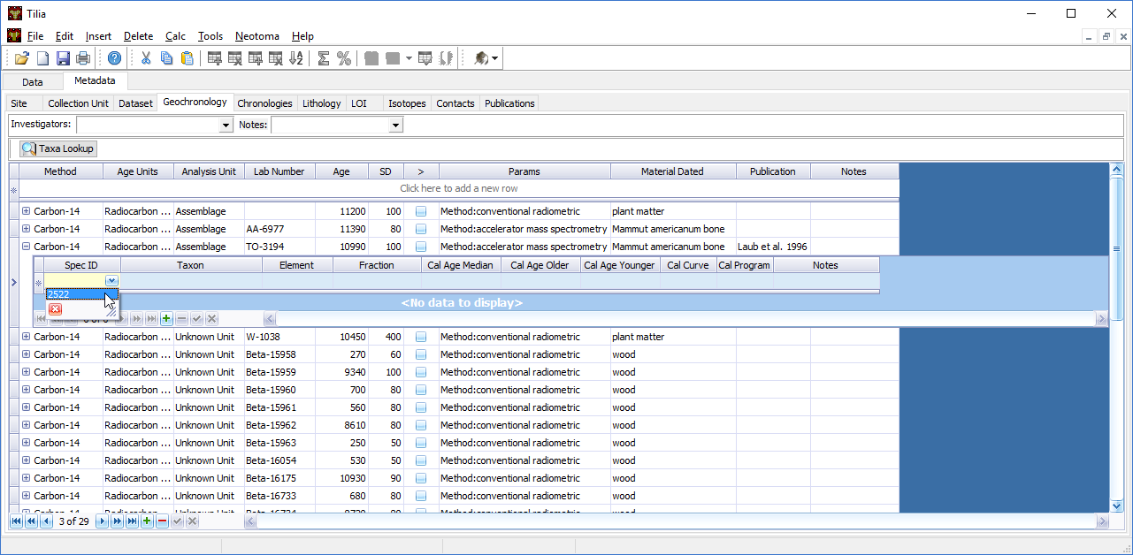
Updating Datasets already in Neotoma

Slide 39
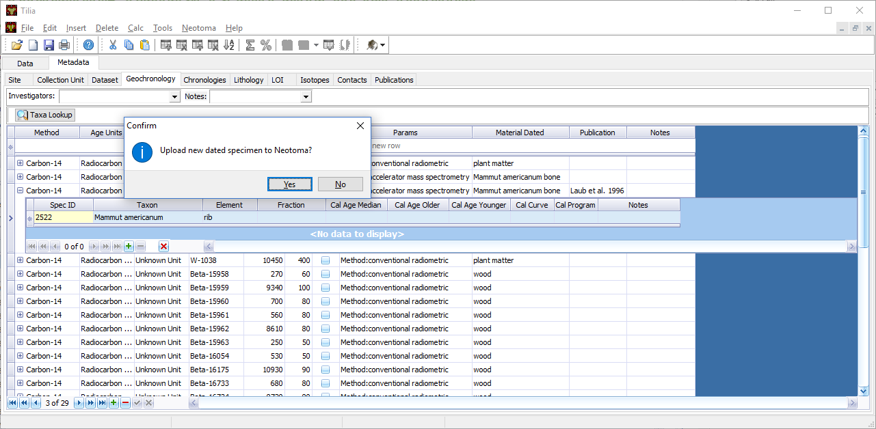
Updating Datasets already in Neotoma

Slide 40
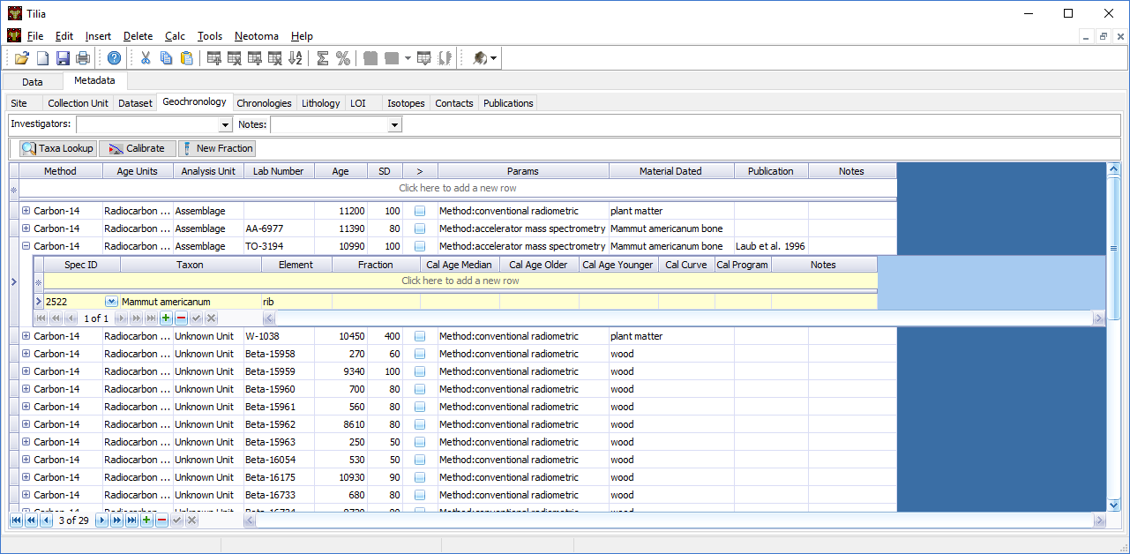
Updating Datasets already in Neotoma

Slide 41

Updating Datasets already in Neotoma

Slide 42
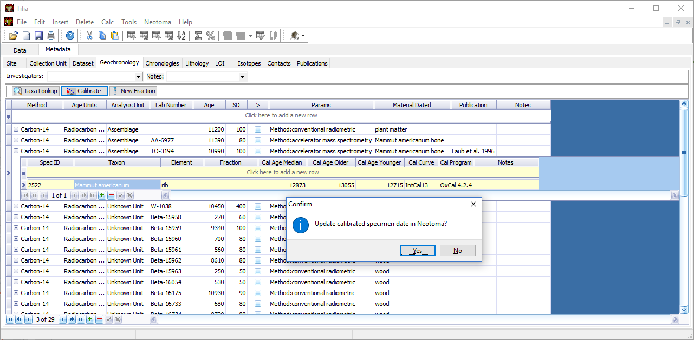
Updating Datasets already in Neotoma

Slide 43
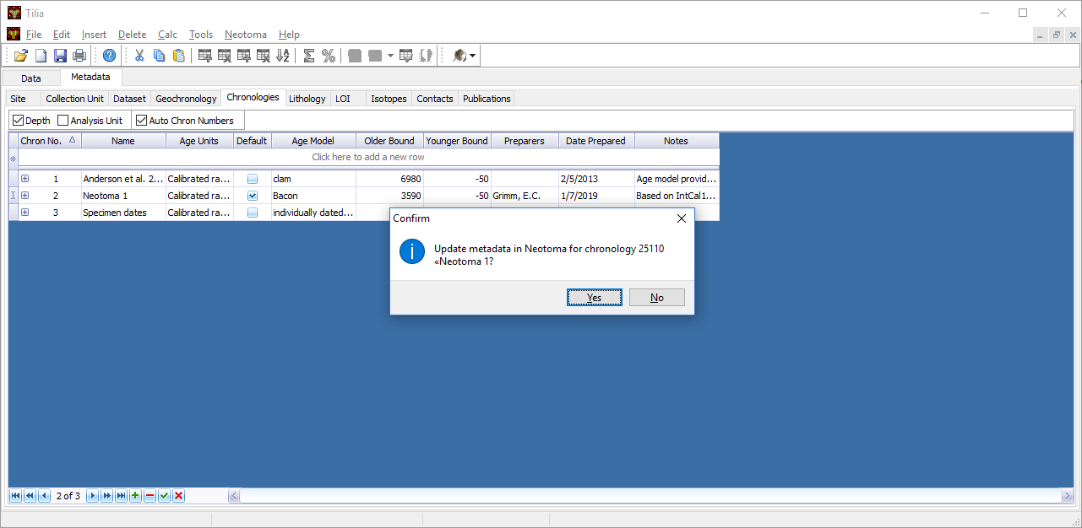
Updating Datasets already in Neotoma

Slide 44
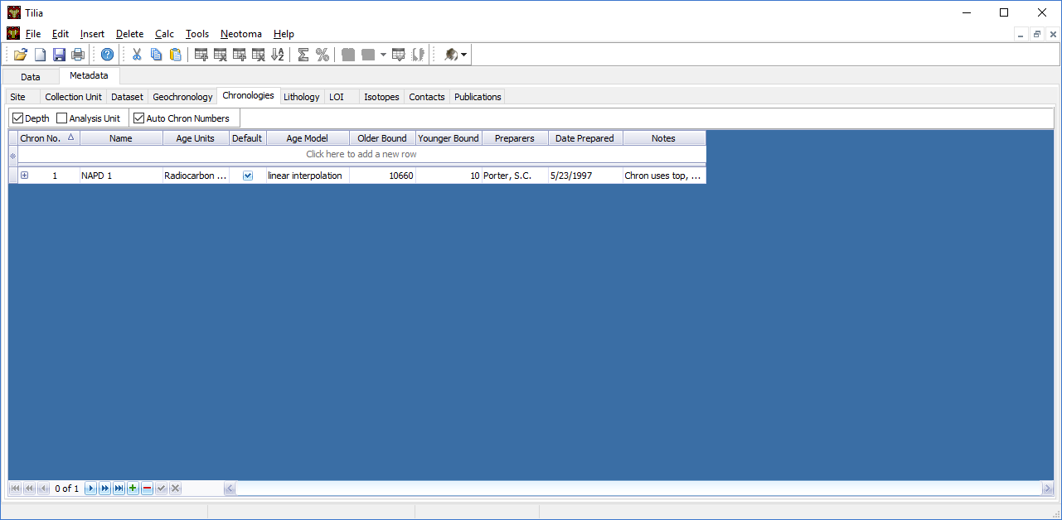
Updating Datasets already in Neotoma

Slide 45
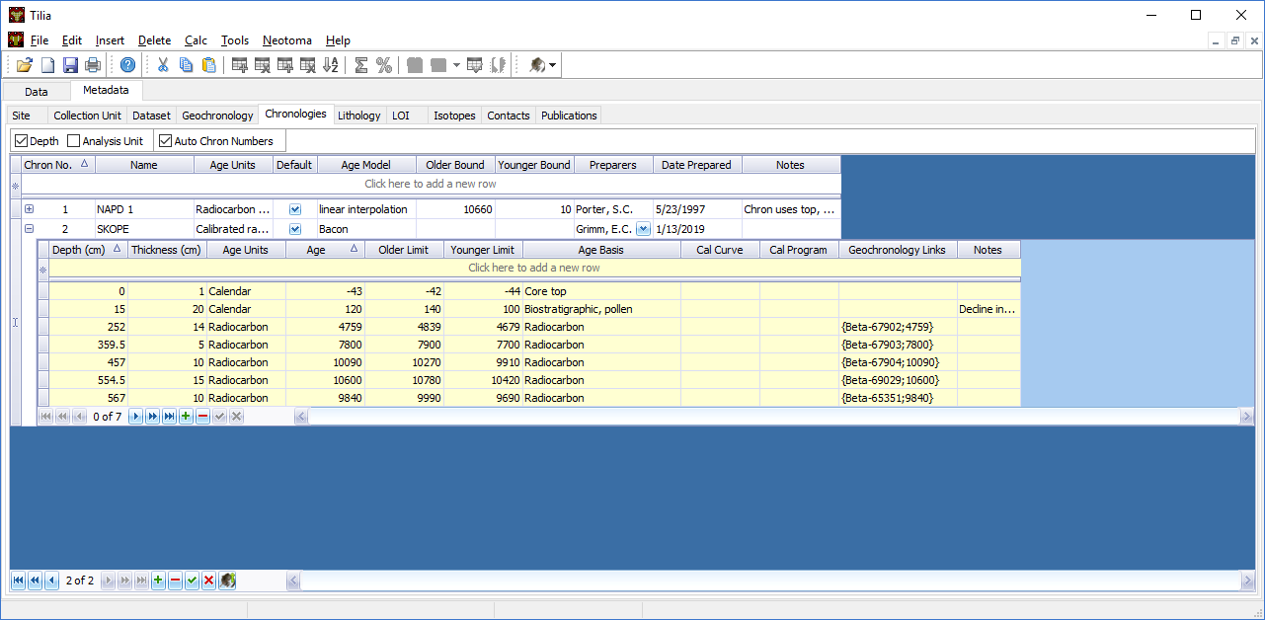
Updating Datasets already in Neotoma

Slide 46
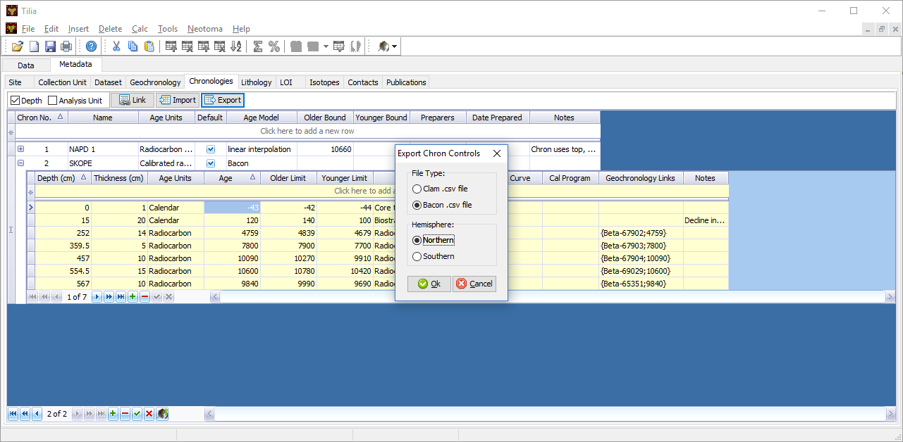
Updating Datasets already in Neotoma

Slide 47
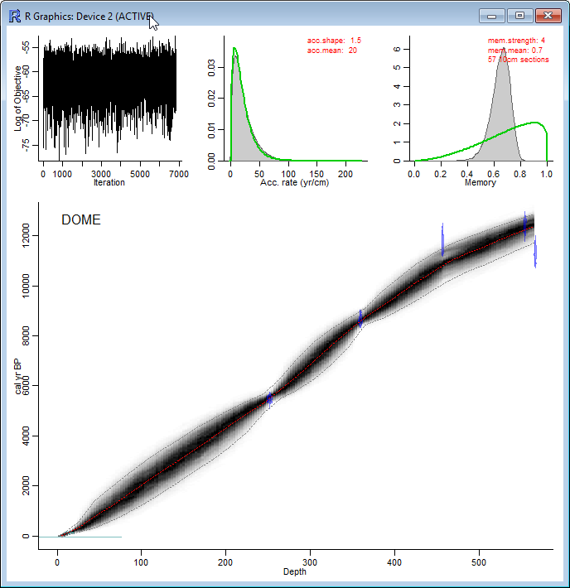
Updating Datasets already in Neotoma

Slide 48
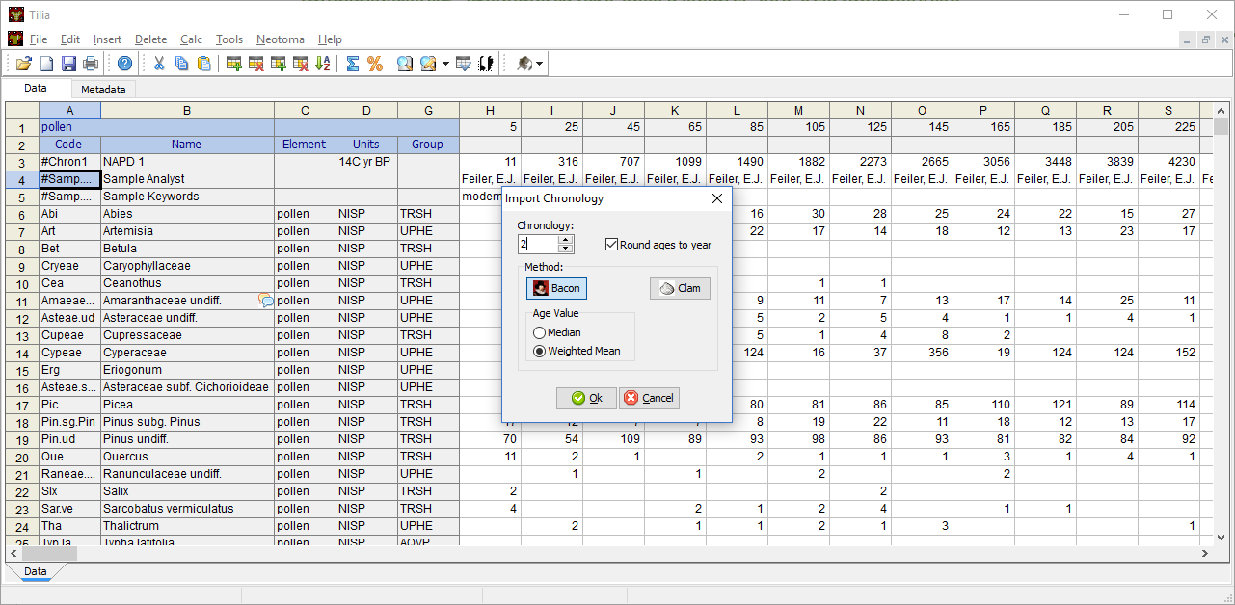
Updating Datasets already in Neotoma

Slide 49
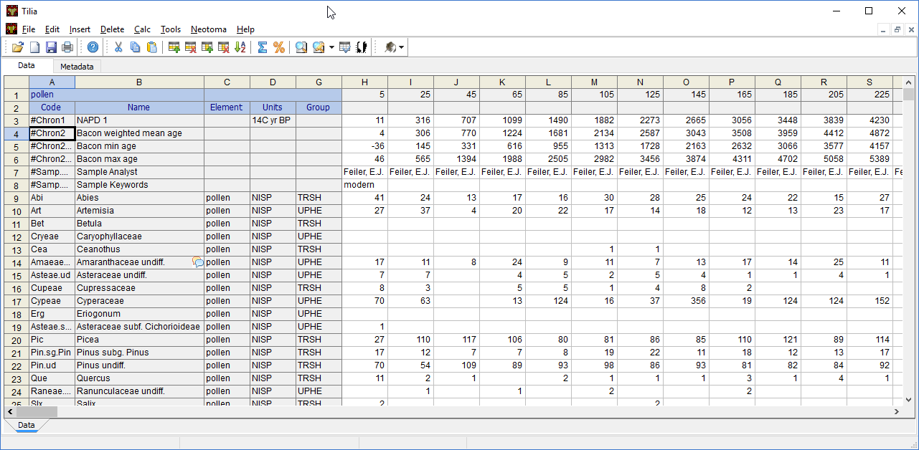
Updating Datasets already in Neotoma

Slide 50
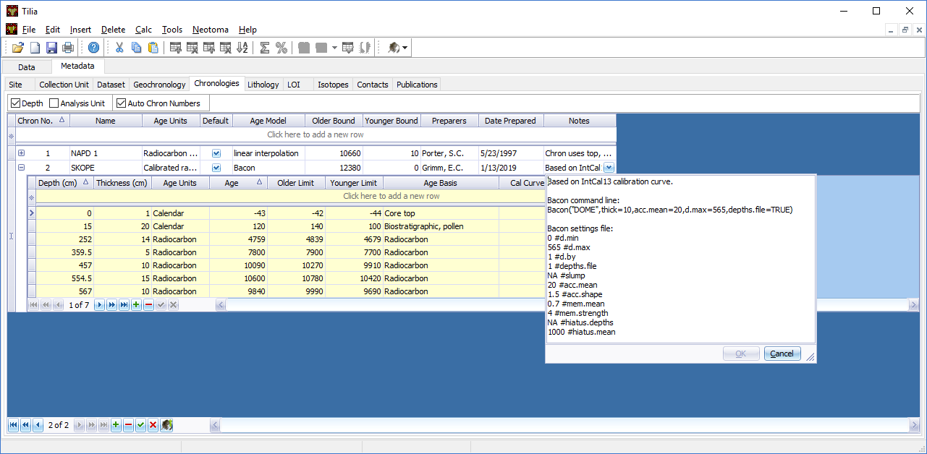
Updating Datasets already in Neotoma

Slide 51
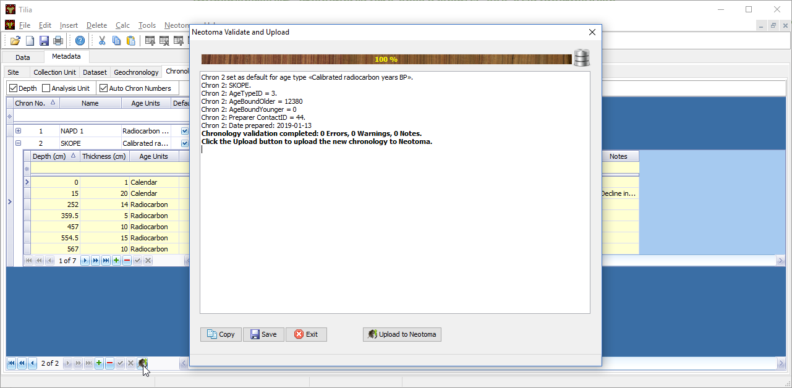
Updating Datasets already in Neotoma

Slide 52
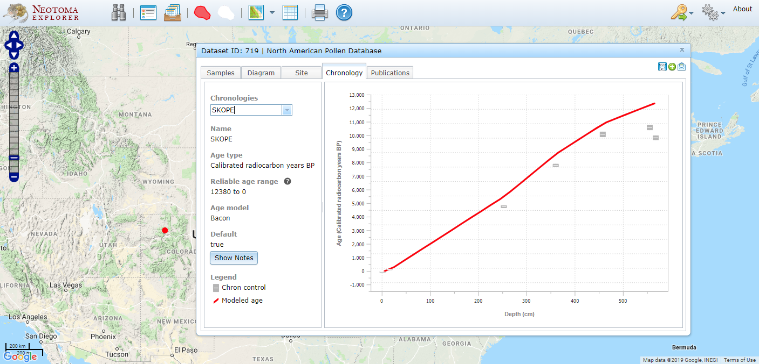
Updating Datasets already in Neotoma

Slide 53
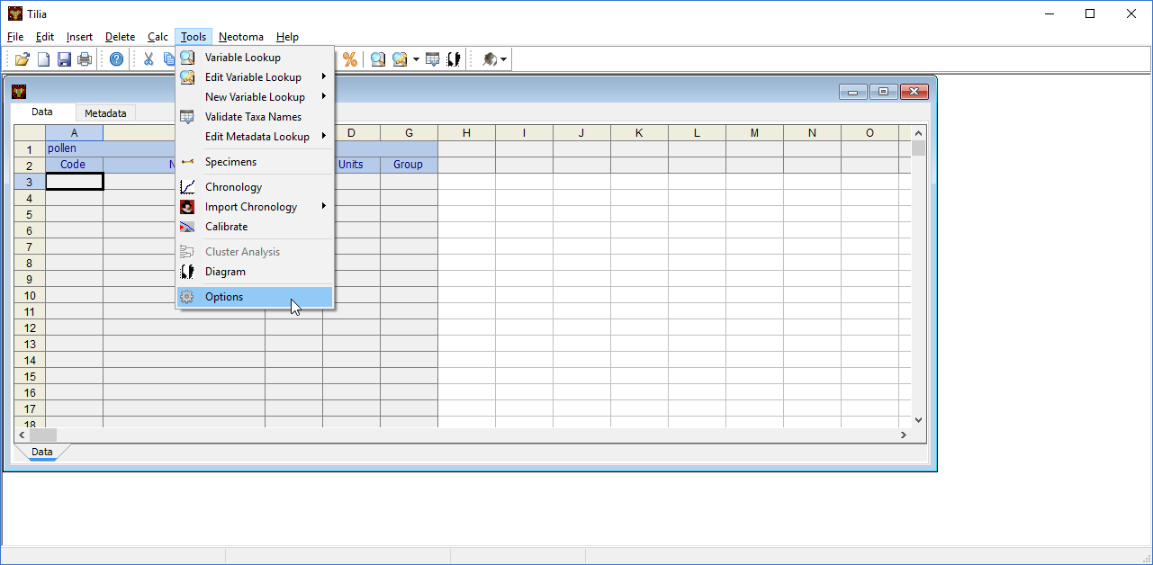

Text based interface for downloading data from Neotoma

Slide 54


Text based interface for downloading data from Neotoma

Slide 55

More to come!

Slide 56

Student licenses

